Slide 2
Topic 3 – Big Data Processing Hadoop, Distributed Data processing
ITECH2302 Big Data Management

Slide 3
Main topics in this week
Parallel data processing
Distributed data processing
Hadoop
3

Slide 4
Big Data processing concept
Partitioning a large dataset into a smaller one can speed up processing.
Big datasets stored on distributed file systems or within a distributed database are already partitioned into smaller databases
Big data is often processed in parallel in a distributed fashion at the location in which it is stored.
Notes:
4

Slide 5
Big Data processing concept
Parallel data processing
Distributed data processing
Hadoop
Processing workloads
Clusters
Notes:
5

Slide 6
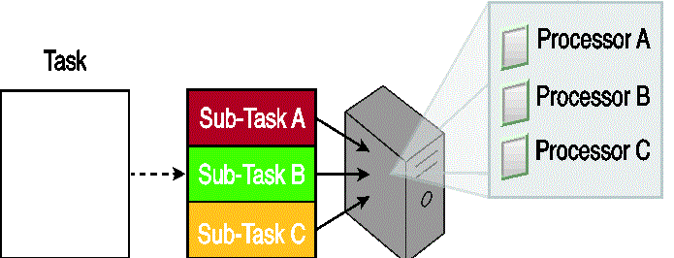
Parallel data processing
A task can be divided into three sub-tasks that are executed in parallel on three different processors within the same machine.
Involves the simultaneous execution of multiple sub-tasks that collectively comprise a larger task.
Is to reduce the execution time by dividing a single larger task into multiple smaller tasks that run concurrently.
Typically is achieved within the confines of a single machine with multiple processors
Notes:
6

Slide 7
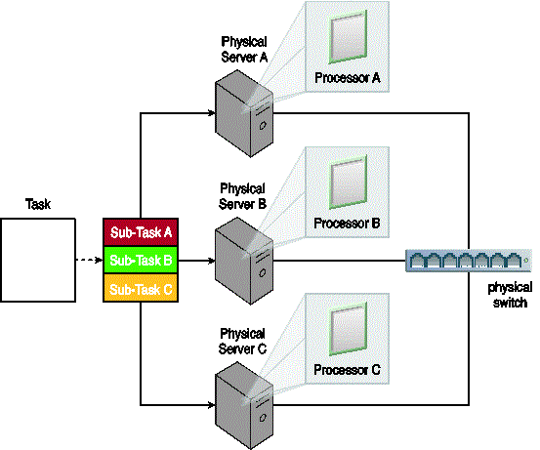
Distributed data processing
An example of distributed data processing.
Is closely related to parallel data processing in that the same principle of divide-and-conquer is applied.
However, is always achieved though physically separate machines that are networked together as a cluster.
Notes:
In figure , a task is divided into three sub-tasks that are then executed on three different machines sharing one physical switch.

Slide 8
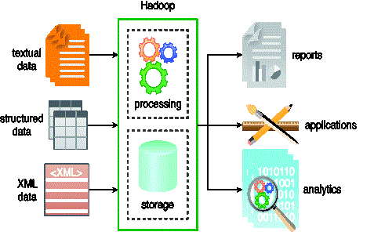
Hadoop
Hadoop is a versatile framework that provides both processing and storage capabilities.
Is an open-source framework for large-scale data storage and data processing.
The Hadoop framework has established itself as a de facto industry platform for contemporary big data solution.
Can be used as an ETL engine or as an analytics engine for processing large amounts of structured, semi-structured and unstructured data.
Notes:
From an analysis perspective, Hadoop implements the MapReduce processing framework.
figure illustrates some of Hadoop’s features.

Slide 9
Processing workloads
A processing workload in big data is defined as the amount and nature of data that is processed within a certain amount of time.
Workloads are usually divided into two types:
Batch
Transactional

Slide 10
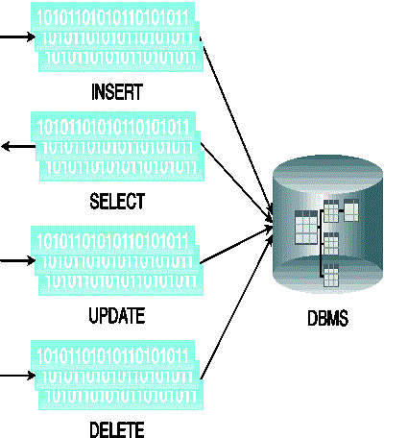
Batch processing
A batch workload can include grouped read/ writes to INSERT, SELECT, UPDATE and DELETE.
Is known as offline processing,
Involves processing data in batches and usually imposes delays, which in turn results in high-latency responses.
Batch workloads typically involve large quantities of data with sequential read/writes and comprise of groups of read or write queries.
Notes:
Queries can be complex and involve multiple joins. OLAP systems commonly process workloads in batches. Strategic BI and analytics are batch-oriented as they are highly read-intensive tasks involving large volumes of data. As shown in figure, a batch workload comprises grouped read/writes that have a large data footprint and may contain complex joins and provide high-latency responses.

Slide 11
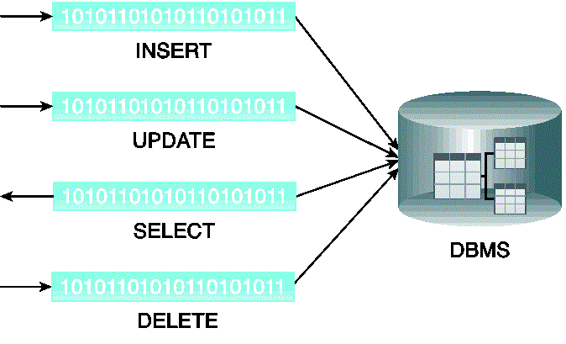
Transactional processing
Transactional workloads have few joins and lower latency responses than batch workloads.
Is also known as online processing.
Transactional workload processing follows an approach
whereby data is processed interactively without delay, resulting in low-latency responses.
Transaction workloads involve small amounts of data with random reads and writes.
Notes:
OLTP and operational systems, which are generally write-intensive, fall within this category. Although these workloads contain a mix of read/write queries, they are generally more write-intensive than read-intensive.
Transactional workloads comprise random reads/.writes that involve fewer joins than business intelligence and reporting workloads. Given their online nature and operational significance to the enterprise, they require low-latency responses with a smaller data footprint, as shown in figure
11

Slide 12
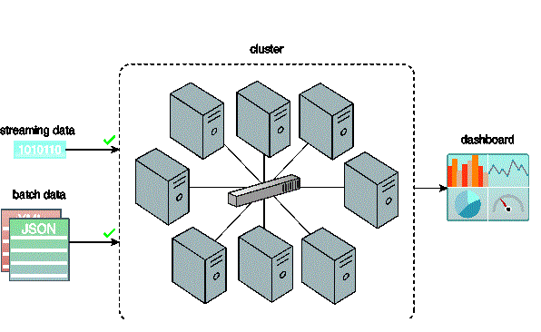
Cluster
A cluster can be utilized to support batch processing of bulk data and realtime processing of streaming data.
Provides the mechanism to enable distributed data processing with linear scalability.
Provides an ideal environment for big data processing as large datasets can be divided into smaller datasets and then processed in parallel in a distributed manner.
Ideally, will be comprised of low-cost commodity nodes that collectively provide increased processing capacity.
Notes:
When leveraging a cluster, big datasets can either be processed in batch mode or real time mode (figure ).
An additional benefit of clusters is that they provide inherent redundancy and fault tolerance, as they consist of physically separate nodes. Redundancy and fault tolerance allow resilient processing and analysis to occur if a network or node failure occurs
12

Slide 13
Big Data processing in batch mode
Data is processed offline in batches
The response time of data processing could vary from minutes to hours.
Data must be persisted to the disk before it can be processed.
Batch mode generally involves
processing a range of large datasets, either on their own or joined together,
essentially addressing the volume and variety characteristics of big datasets.
The majority of big data processing occurs in batch mode.
It is relatively simple, easy to set up and low in cost compared to real time mode.
Notes:
13

Slide 14
Batch processing with MapReduce
MapReduce is a widely used implementation of a batch processing framework.
It is highly scalable and reliable and is based on the principle of divide-and-conquer,
It divides a big problem into a collection of smaller problems that can each be solved quickly.
MapReduce has roots in both distributed and parallel computing.
Notes:
MapReduce is a batch-oriented processing engine(figure ) used to process large datasets using parallel processing developed over clusters of commodity hardware.
It provides built-in fault tolerance and redundancy.
14

Slide 15
Batch processing with MapReduce
MapReduce does not require that the input data conform to any particular data model.
It can be used to process schema-less datasets.
A dataset is broken down into multiple smaller parts, and
Operations are performed on each part independently and in parallel.
The results from all operations are then summarised to arrive at the answer.
MapReduce is based on Google’s research paper on the subject, published in early 2000.
Notes:
Because of the coordination overhead involved in managing a job, the MapReduce processing engine generally only supports batch workloads as this work is not expected to have low latency. MapReduce is based on Google’s research paper on the subject, published in early 2000.
15

Slide 16
Traditional data processing paradigm
Traditionally, data processing requires moving data from the storage node to the processing node that runs the data processing algorithm.
This approach works fine for smaller datasets;
however with large datasets, moving data can incur more overhead than the actual processing of the data.
Notes:
The MapReduce processing engine works differently compared to the traditional data processing paradigm.
16

Slide 17
Data processing with MapReduce
With MapReduce, the data processing algorithm is moved to the nodes that store the data.
The data processing algorithm executes in parallel on these nodes,
Thereby it eliminates the need to move the data first.
This not only saves network bandwidth but is also results in a large reduction in processing time for large datasets, since processing smaller chunks of data in parallel is much faster.
Notes:
17

Slide 18
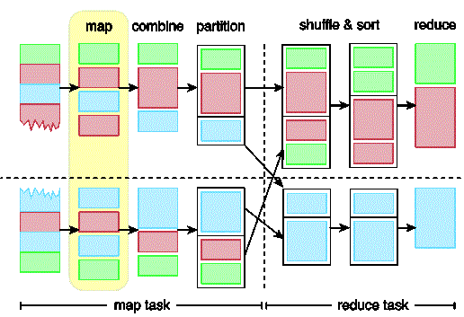
Map and Reduce Tasks
An illustration of a MapReduce job with the map stage highlighted.
Each MapReduce job is composed of a map task and a reduce task.
Map tasks
map
combine (optional)
partition
Reduce tasks
shuffle and sort
reduce
Notes:
A single processing run of the MapReduce processing engine is known as a MapReduce job. Each MapReduce job is composed of a map task and a reduce task and each task consists of multiple stages. Figure shows the map and reduce task, along with their individual stages.
18

Slide 19
Map stage
Dataset file is divided into multiple smaller splits.
Each split is parsed into its constituent records as a key-value pair.
The key is usually the ordinal position of the record, and
The value is the actual record.
The parsed key-value pairs for each split are then sent to a map function or mapper, with one mapper function per split.
The map function executes user-defined logic.
Each split generally contains multiple key-value pairs, and the mapper is run once for each key-value pair in the split.
Notes:
19

Slide 20
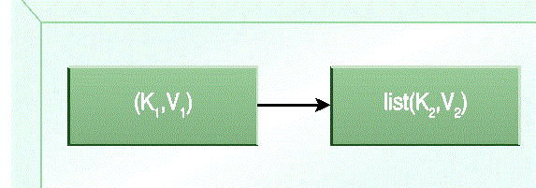
Map stage
A summary of the map stage.
3. The mapper processes each key-value pair as per the user-defined logic and further generates a key-value pair as its output.
The output key can either be the same as the input key or a substring value from the input value, or another serializable user-defined object.
Similarly, the output value can either be the same as the input value or substring value form the input value, or another serializable user-defined object.
4. When all records of the split have been processed, the output is a list of key-value pairs
where multiple key-value pairs can exist for the same key.
Notes:
It should be noted that for an input key-value pair, a mapper may not produce any output key-value pair(filtering) or can generate multiple key-value pairs( demultiplexing). the map stage can be summarized by the equation shown in figure
20

Slide 21
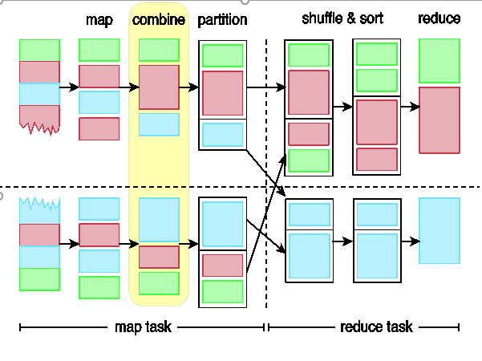
Combine stage
MapReduce engine provides an optional combine function(combiner)
Combiner summarizes a mapper’s output before it gets processed by the reducer.
The combine stage groups the output from the map stage.
Notes:
Generally, the output of the map function is handled directly by the reduce function. However, map tasks and reduce tasks are mostly run over different nodes. This requires moving data between mappers and reducers. This data movement can consume a lot of valuable bandwidth and directly contributes to processing latency.
With larger datasets. The time taken to move the data between map and reduce stages can exceed the actual processing undertaken by the map and reduce tasks. For this reason, the MapReduce engine provides an optional combine function(combiner) that summarizes a mapper’s output before it gets processed by the reducer. Figure illustrates the consolidation of the output from the map stage by the combine stage.
21

Slide 22
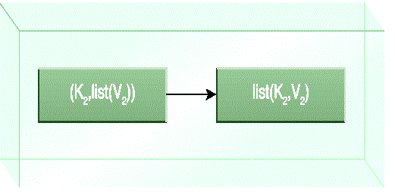
Combine stage
A summary of the combine stage.
A combiner is essentially a reducer function that locally groups a mapper’s output on the same node as the mapper.
A reducer function can be used as a combiner function, or a custom user-defined function can be used.
The MapReduce engine combines all values for a given key from the mapper output, creating multiple key-value pairs as input to the combiner
In combiner, the key is not repeated and the value exists as a list of all corresponding values for that key.
Notes:
The combiner stage is only an optimization stage, and may therefore not even be called by the MapReduce engine.
For example, a combiner function will work for finding the largest or the smallest number , but will not work for finding the average of all numbers since it only works with a subset of the data. The combine stage can be summarized by the equation shown in figure
22

Slide 23
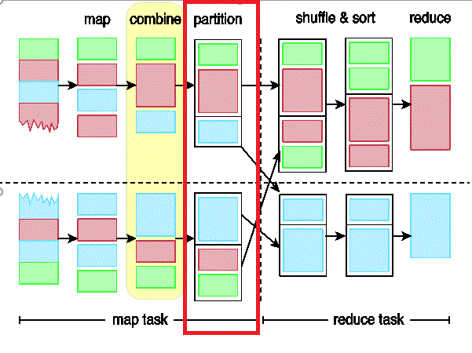
Partition stage
The partition stage assigns output from the map task to reducers.
A partitioner divides the output from the mapper or combiner( if specified and called by the MapReduce engine) into partitions between reducer instances.
The number of partitions will equal the number of reducers.
All records for a particular key are assigned to the same partition.
The MapReduce engine guarantees a random and fair distribution between reducers.
Notes:
During the partition stage, if more than one reduce is involved , a partitioner divides the output from the mapper or combiner( if specified and called by the MapReduce engine) into partitions between reducer instances. The number of partitions will equal the number of reducers. Figure shows the partition stage assigning the outputs from the combine stage to specific reducers.
Although each partition contains multiple key-value pairs, all records for a particular key are assigned to the same partition. The MapReduce engine guarantees a random and fair distribution between reducers while making sure that all of the same keys across multiple mappers end up with the same reducer instance.
23

Slide 24
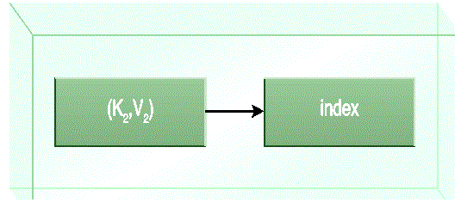
Partition stage
A summary of the partition stage.
The partition function is the last stage of the map task,
It returns the index of the reducer to which a particular partition should be sent.
The Partition stage can be summarized by the equation in figure
Notes:
Depending on the nature of the job, certain reducers can sometimes receive a large number of key-value pairs compared to others. As a result of this uneven workload, some reducers will finish earlier than others. Overall, this is less efficient and leads to longer job execution times than if the work was evenly split across reducers. This can be rectified by customizing the partitioning logic in order to guarantee a fair distribution of key-value pairs.
The partition function is the last stage of the map task, it returns the index of the reducer to which a particular partition should be sent. The Partition stage can be summarized by the equation in figure.
24

Slide 25
Reduce tasks – stage of shuffle and sort
Output from all partitioners is copied across the network to the nodes running the reduce task.
The list based key-value output from each partitioner can contain the same key multiple times.
Next, the MapReduce engine automatically groups and sorts the key-value pairs according to the keys
the output contains a sorted list of all input keys and their values with the same keys appearing together.
Notes:
During the first stage of the reduce task, output from all partitioners is copied across the network to the nodes running the reduce task. This is known as shuffling. The list based key-value output from each partitioner can contain the same key multiple times.
Next, the MapReduce engine automatically groups and sorts the key-value pairs according to the keys so that the output contains a sorted list of all input keys and their values with the same keys appearing together. The way in which keys are grouped and sorted can be customized.
25

Slide 26
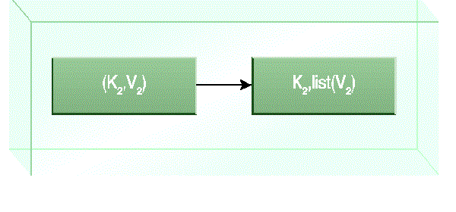
Reduce tasks – stage of shuffle and sort
A summary of the shuffle and sort stage.
This merge creates a single key-value pair per group,
where key is the group key and the value is the list of all group values.
This stage can be summarized by the equation in figure
Notes:
26

Slide 27
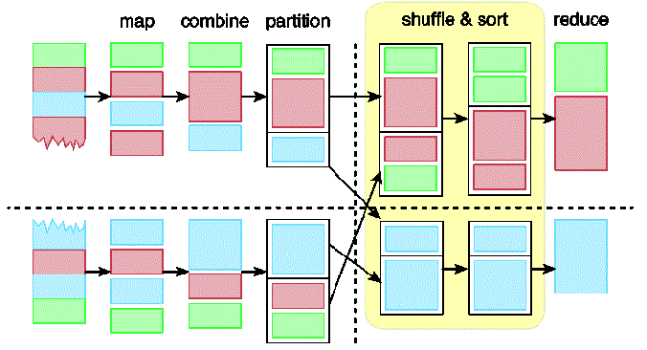
Reduce tasks – stage of shuffle and sort
During the shuffle and sort stage, data is copied across the network to the reducer nodes and sorted by key.
Notes:
Figure depicts a hypothetical MapReduce job that is executing the shuffle and sort stage of the reduce task.
27

Slide 28
Reduce tasks – stage of Reduce
Reduce is the final stage of the reduce task
Reducer will either further summarize its input or will emit the output without making any changes.
For each key-value pair that a reducer receives, the list of values stored in the value part of pair is processed and another key-value pair is written out.
The output key can either be the same as the input key or a substring value form the input value, or another serializable user-defined object.
Notes:
Reduce is the final stage of the reduce task. Depending on the user-defined logic specified in the reduce function(reducer), the reducer will either further summarize its input or will emit the output without making any changes. In either case, for each key-value pair that a reducer receives, the list of values stored in the value part of pair is processed and another key-value pair is written out.
The output key can either be the same as the input key or a substring value form the input value, or another serializable user-defined object.
28

Slide 29
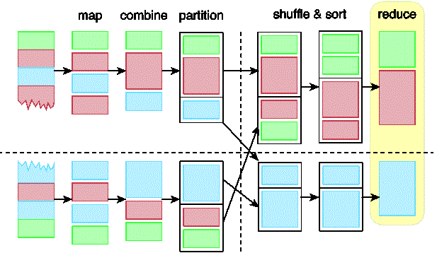
Reduce tasks – stage of Reduce
The reduce stage is the last stage of the reduce task.
A reducer may not produce any output key-value pair(filtering) or can generate multiple key-value pairs(demultiplexing).
The output of the reducer is then written out as a separate file, one file per reducer.
Notes:
Note that just like the mapper, for the input key-value pair, a reducer may not produce any output key-value pair(filtering) or can generate multiple key-value pairs(demultiplexing). The output of the reducer, that is the key-value pairs, is then written out as a separate file, one file per reducer. This is depicted in figure which highlights the reduce stage of the reduce task. To view the full output from the MapReduce job, all the file parts must be combined.
29

Slide 30
MapReduce examples - 1
Notes:
in this picture, input to MapReduce process is a set of geometric shapes(diamond, circle, square, star and triangle). the objective of this MapReduce is to count the number of geometric shapes of each type.
MapReduce system first reads the input file and splits it into multiple pieces. in this example, there are two splits
these splits are then processed by multiple map programs running in parallel on nodes of cluster. here role of each map program in this case is to group the data in a split by the type of geometric shape. we can see that there are four groups of geometric shapes: on the top split, 2 diamonds, 2 circles. 1 square, and 3 stars; on the bottom split,2 squares, 3 triangles, 1 circle, and 2 diamonds
MapReduce system then takes output from each map program and merges(shuffles/sorts) the results for input to reduce the program, which calculates the sum of the number of different types of geometric shapes:4 diamonds, 3 circles, 3 squares...

Slide 31
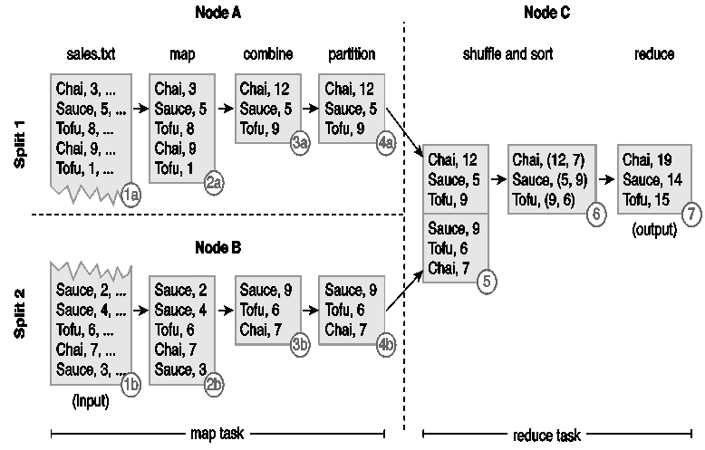
MapReduce examples - 2
An example of MapReduce in action.
The input(sales.txt) is divided into two splits.
Two map tasks running on two different nodes, Node A and Node B, extract product and quantity from the respective split’s records in parallel.
The output from each map function is a key-value pair where product is the key while quantity is the value
The combiner then performs local summation of product quantities
As there is only one reduce task, no partitioning is performed.
Notes:
The following steps are shown in figure
The input(sales.txt) is divided into two splits.
Two map tasks running on two different nodes, Node A and Node B, extract product and quantity from the respective split’s records in parallel. The output from each map function is a key-value pair where product is the key while quantity is the value
.The combiner then performs local summation of product quantities
As there is only one reduce task, no partitioning is performed.
31

Slide 32
MapReduce examples - 2
An example of MapReduce in action.
5. the output from the two map tasks is then copied to a third node, Node C, that runs the shuffle stage as part of the reduce task.
6. The sort stage then groups all quantities of the same product together as a list
7. Like the combiner, the reduce function then sums up the quantities of each unique product in order to create the output.
Notes:
5. the output from the two map tasks is then copied to a third node, Node C, that runs the shuffle stage as part of the reduce task.
6. The sort stage then groups all quantities of the same product together as a list
7 . Like the combiner, the reduce function then sums up the quantities of each unique product in order to create the output.
32

Slide 33
MapReduce Algorithms
MapReduce algorithm’s design principle
MapReduce works on the principle of divide-and-conquer.
The divide-and-conquer principle is generally achieved using one of the following approaches
1. Task parallelism,
2. Data Parallelism
Notes:
Unlike traditional programming model, MapReduce follow a distinct programming model. In order to understand how algorithms can be designed or adapted to this programming model, its design principle first needs to be explored.
As described earlier, MapReduce works on the principle of divide-and-conquer. However, it is important to understand the semantics of this principle in the context of MapReduce. The divide-and-conquer principle is generally achieved using one of the following approaches
1. Task parallelism,
2. Data Parallelism
33

Slide 34
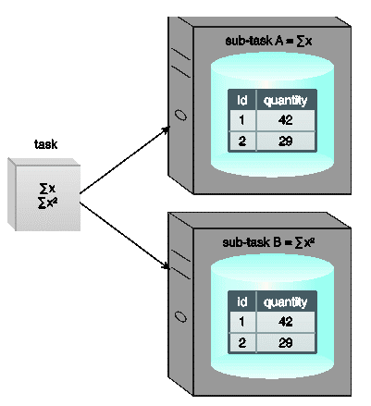
MapReduce Algorithms
A task is split into two sub-tasks, Sub-task A and Sub-task B, which are then run on two different nodes on the same dataset.
1. Task parallelism,
refers to the parallelization of data processing by
dividing a task into sub-tasks and
running each sub-task on a separate processor, generally on a separate node in a cluster(figure )
Notes:
each sub-task generally executes a different algorithm, with its own copy of the same data or different data as its input, in parallel. Generally, the output from multiple sub-tasks is joined together to obtain the final set of results.
34

Slide 35
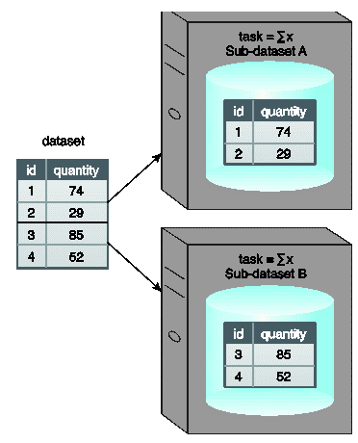
MapReduce Algorithms
A dataset is divided into two sub-datasets, Sub-dataset A and Sub-dataset B, which are then processed on two different nodes using the same function.
2. Data parallelism,
refers to the parallelization of data processing by
dividing a dataset into multiple datasets and
processing each sub-dataset in parallel
Notes:
the sub-datasets are spread across multiple nodes and are all processed using the same algorithm. Generally, the output from each processed sub-dataset is joined together to obtain the final set of results
35

Slide 36
Big data processing
Big Dataset is divided into splits.
Each split is then processed by its own instance of the map function,
In MapReduce, operations are divided among the map and reduce functions.
Map and reduce tasks are independent and in turn run isolated from one another.
Each instance of a map or reduce function runs independently of other instances.
Notes:
In MapReduce, operations are divided among the map and reduce functions. Map and reduce tasks are independent and in turn run isolated from one another. Furthermore, each instance of a map or reduce function runs independently of other instances.
36

Slide 37
Big data processing
In MapReduce, the map and reduce function signatures are constrained to a set of key-value pairs.
This is the only way that a map function can communicate with a reduce function.
the logic in the map function is dependent on how records are parsed, which further depends on what constitutes a logic data unit within the dataset.
Notes:
37

Slide 38
Key points when developing a MapReduce algorithm
Use of relatively simplistic algorithmic logic, and then aggregating the results in some manner
Availability of dataset in a distributed manner partitioned across a cluster
Dividing algorithm logic into map and reduce functions
Emitting the correct key from the map function along with all the required data as values
Emitting the correct key from the reduce function along with the required data as value
Notes:
Use of relatively simplistic algorithmic logic, such that the required result can be obtained by applying the same logic to different portion of a dataset in parallel and then aggregating the results in some manner
Availability of dataset in a distributed manner partitioned across a cluster so that multiple map functions can process different subsets of a dataset in parallel.
Dividing algorithm logic into map and reduce functions so that the logic in map function is not dependent on the completed dataset, since only data within a single split is available
Emitting the correct key from the map function along with all the required data as values because the reduce function’s logic can only process those values that were emitted as part of the key-value pairs from the map function
Emitting the correct key from the reduce function along with the required data as value because the output from each reduce function becomes final output of MapReduce algorithm
38

Slide 39
End of the lecture
Questions, comments
Notes:
39

